Slide 1
Python Workshop Series Temple University
Rich Lee

Slide 2
About me
2010
Temple University
Actuarial Science
2014
2017
Cigna
AEDP
Radian
2018
FSA
2019 –
2016
Columbia University
Masters in Statistics
???
Quantitative Modeler
NOT a programmer
NOT an actuary (anymore)
So why am I here?

Slide 3
Python workshops
What is this?
What is this not?
Get you coding in Python quickly
Introduction to Python tools most useful in an entry-level analytical / data-driven job
Give you a foundation to learn more on your own
A series of 4 weekly workshops
Convince you Python is awesome!
NOT a computer science course
No theory
No prerequisites
NOT a class
Ask questions
Interrupt me
Code!
NOT everything you need to know!

Slide 4
Workshop Schedule
Python Basics: Friday, March 13th 2020, 12pm - 1:50pm, Alter 745
Data Wrangling: Friday, March 20th 2020, 12pm - 1:50pm, Alter 746
Model Building: Friday, March 27th 2020, 12pm - 12:50pm, Alter 745
Luncheon: 1pm – 1:50pm
Advanced Topics: Friday, April 3rd 2020, 12pm – 1:50pm, Alter 745

Slide 5
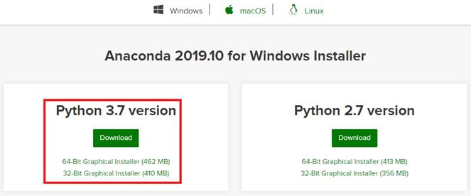
Download & installation
Anaconda
https://www.anaconda.com/distribution/#download-section
GitHub
https://github.com/richpy/temple-python-workshops
Google Colab
https://colab.research.google.com/

